Slide 1
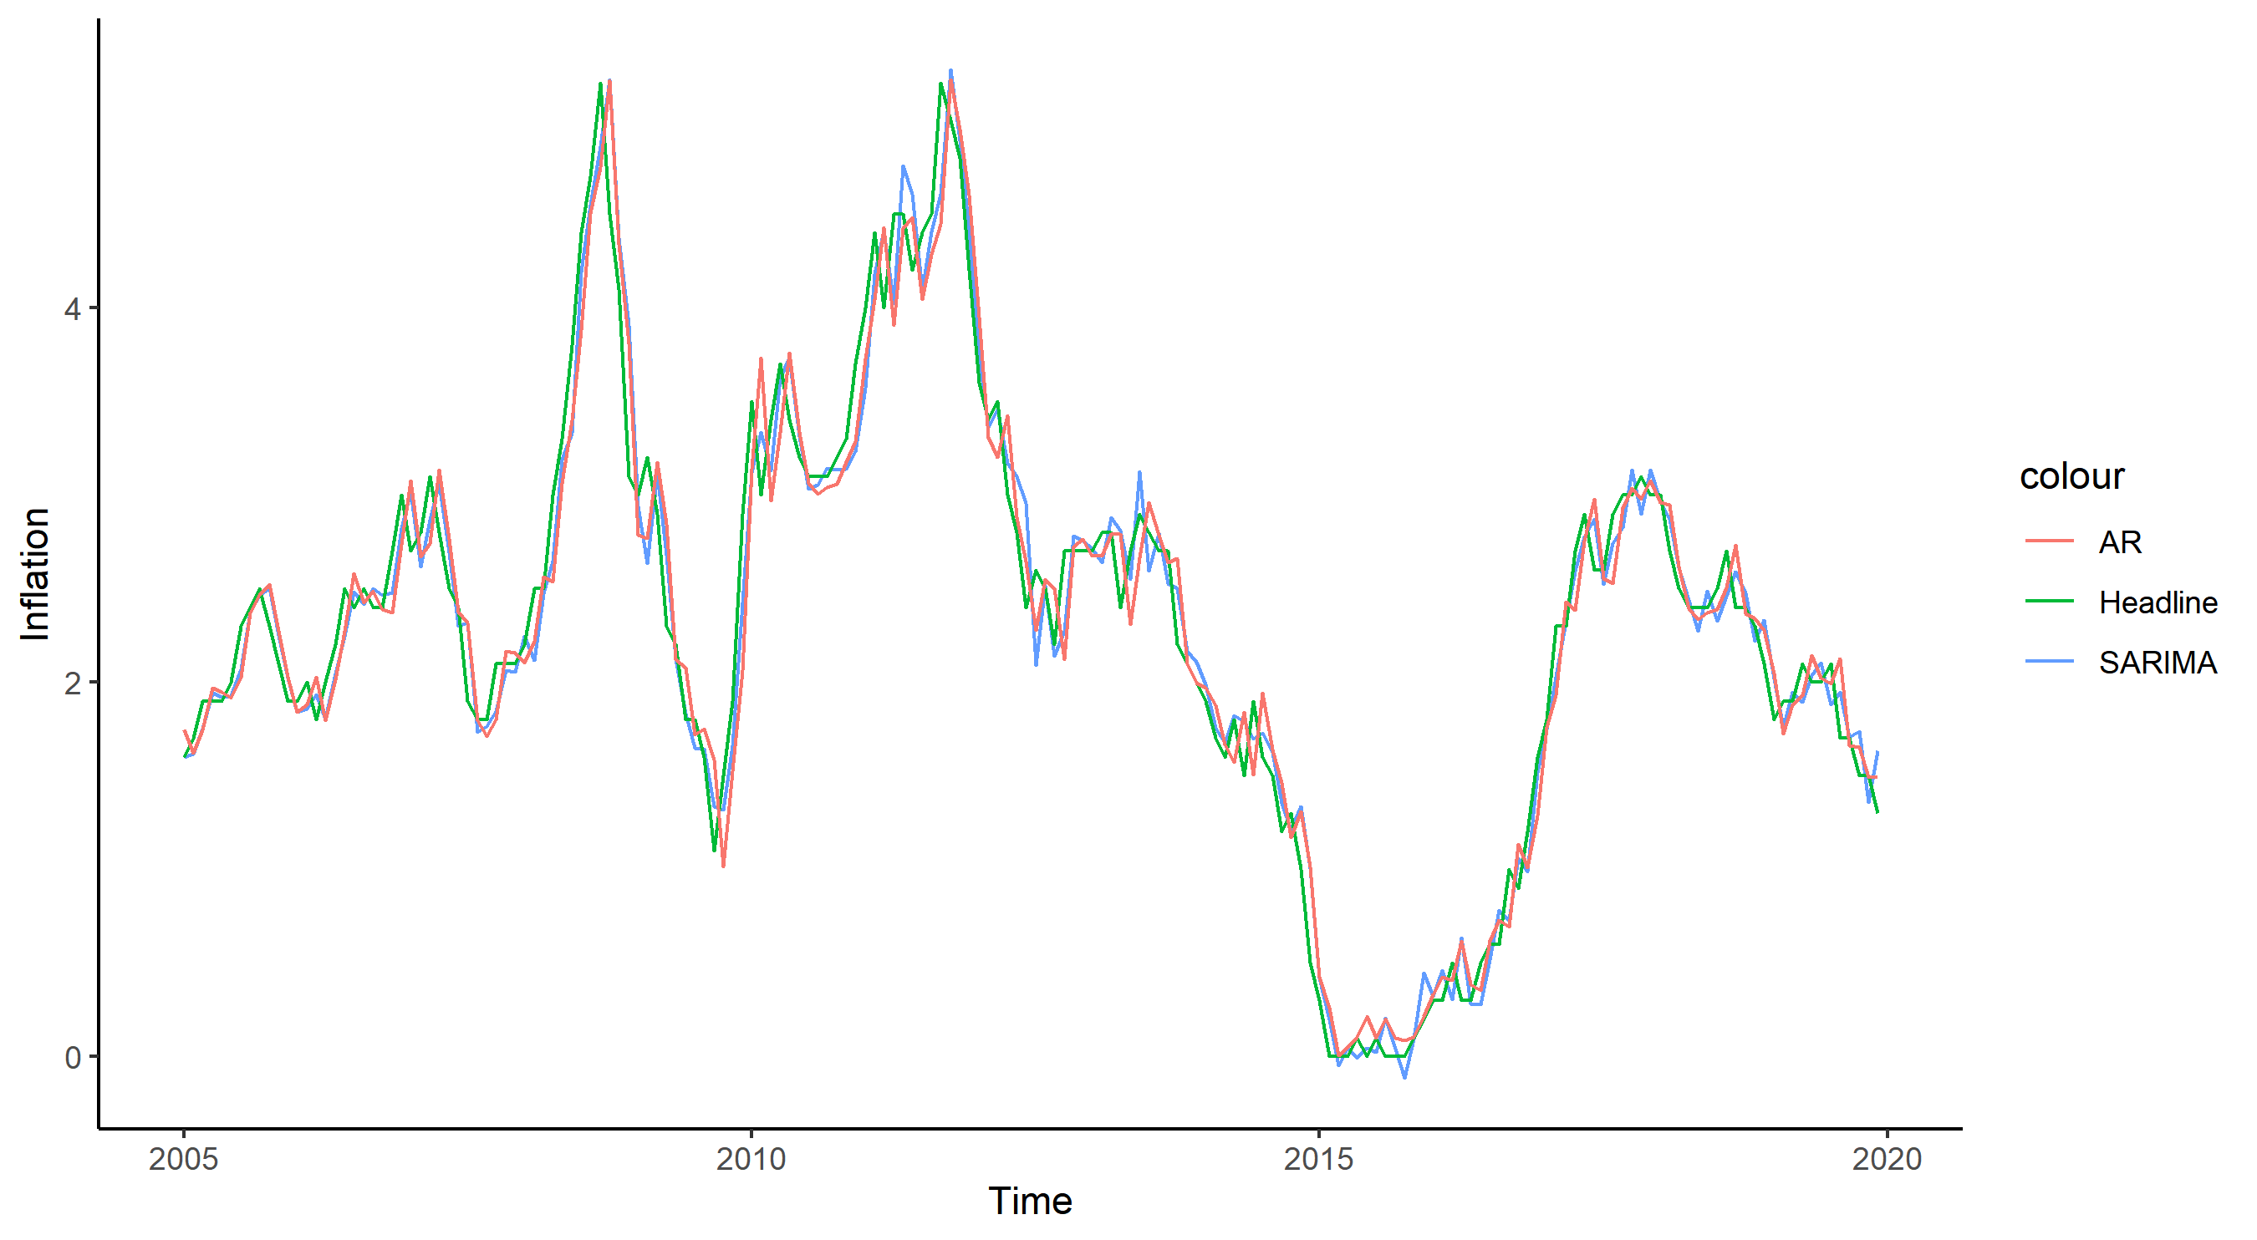

Slide 2
4
colour
Inflation
AR
Headline
2
SARIMA
0
2005
2010
2015
2020
Time

